Slide 1

Tuan-Thanh Phan
Child Health Care
Demo Application

Slide 2
Contents
1. Overview
2. Analysis
3. Designs

Slide 3
1. Overview
The Child HealthCare App aims to provide a comprehensive and user-friendly platform for parents and caregivers to monitor, manage, and track the health and well-being of their children.
The app will facilitate the input of health-related information, allow for error reporting, and enable seamless communication between parents and healthcare professionals.

Slide 4
2. Analysis

Slide 5
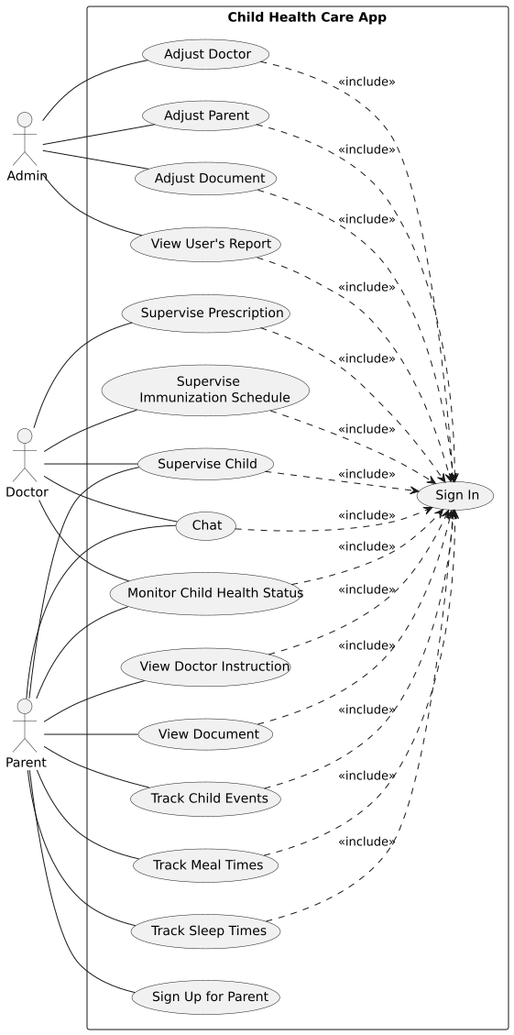
System Usecase

Slide 6
Actors in the system
# | Actor Name | Definition
1 | Admin | Who manages the accounts of doctors and parents, as well as their associated children, to maintain tighter control over the system.
2 | Doctor | A medical professional who has been added to the system to help care for the children and exchange necessary information with the parents.
3 | Parent | They can track their child’s developmental parameters, view instructional documents, and receive notifications from the doctor.

Slide 7
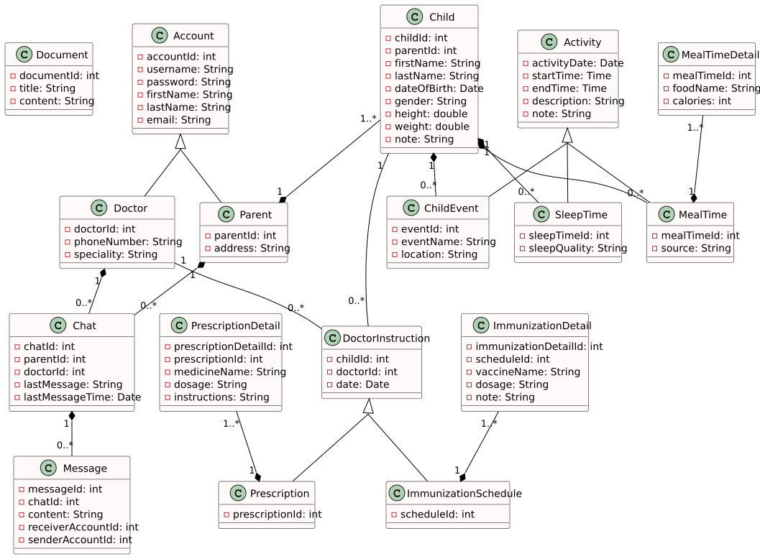
Class diagram

Slide 8
3. Designs

Slide 9
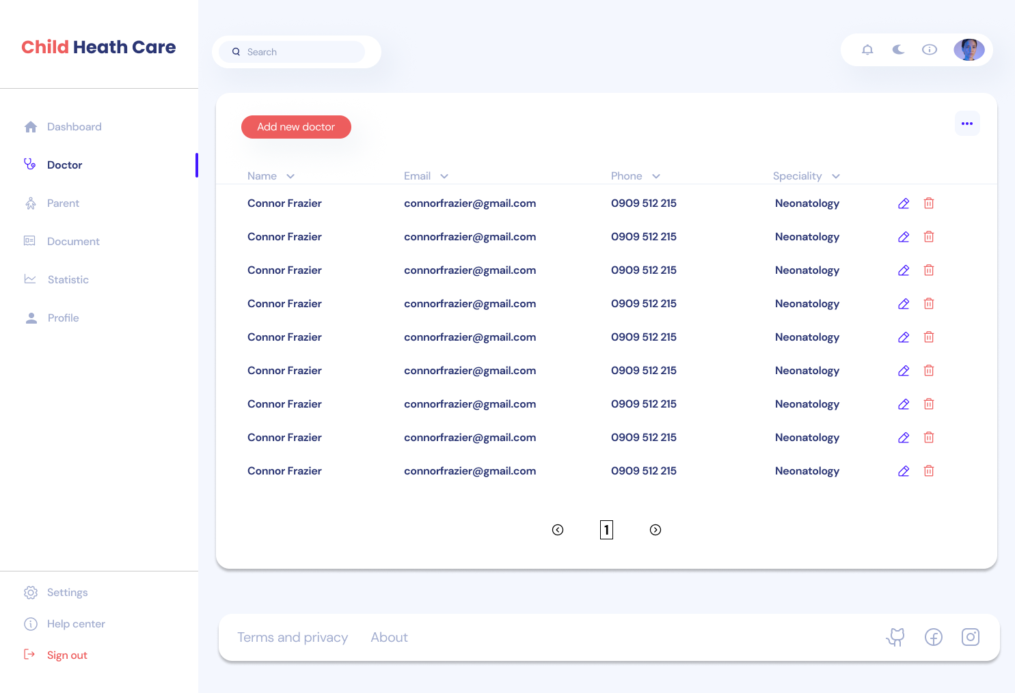
Admin screen

Slide 10
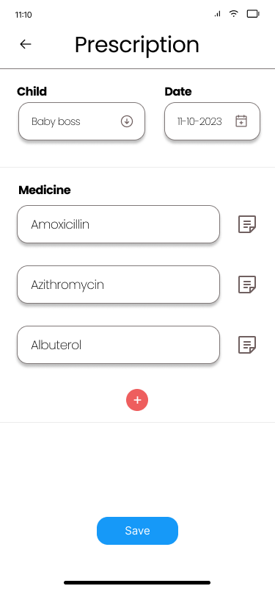
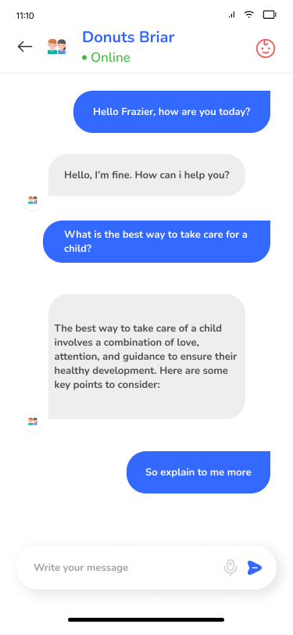
Doctor screen

Slide 11
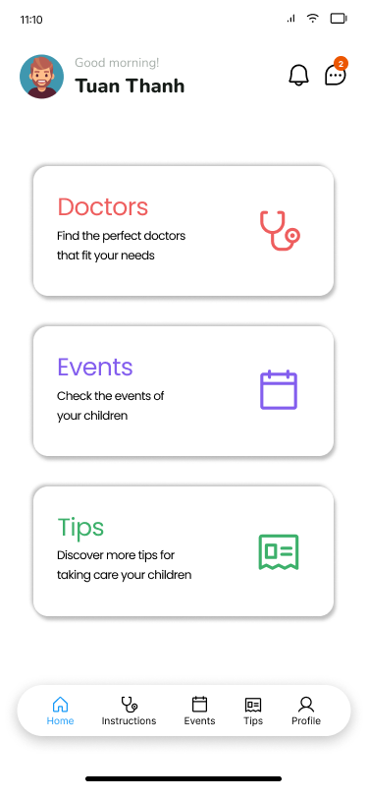
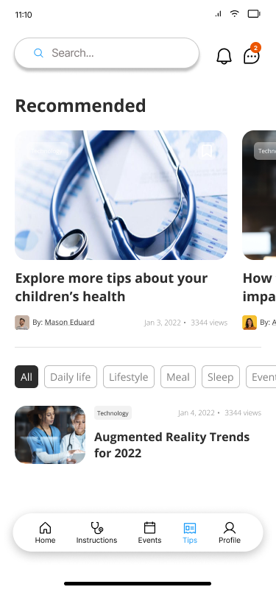
Parent screen

Slide 12
Thank You For Taking Your Time

